Slide 1
Gokulavasan R
711721104039
Final Project
3/21/2024 Annual Review

Slide 2
PROJECT TITLE
Image Caption Generator
3/21/2024 Annual Review

Slide 3


AGENDA
Problem Statement
Project Overview
End Users
Our solution and Value Proposition
Key Features
Modelling Approach
Results and Evaluation
3/21/2024 Annual Review

Slide 4

PROBLEM STATEMENT
Develop an image caption generator using a combination of Convolutional Neural Networks (CNNs) and Long Short-Term Memory (LSTM) networks.
3/21/2024 Annual Review

Slide 5

PROJECT OVERVIEW
The project involves creating an image caption generator using Convolutional Neural Networks (CNNs) and Long Short-Term Memory (LSTM) networks. The goal is to automatically generate descriptive captions for images.
3/21/2024 Annual Review

Slide 6

WHO ARE THE END USERS?
1.Visually Impaired Individuals
2.Content Creation Platforms
3.E-commerce Platforms
4.Educational Institutions
5.Content Moderation Systems
3/21/2024 Annual Review

Slide 7

YOUR SOLUTION AND ITS VALUE PROPOSITION
SOLUTION:
The solution is an image caption generator that utilizes a combination of Convolutional Neural Networks (CNNs) and Long Short-Term Memory (LSTM) networks. The system takes an image as input and generates descriptive captions in natural language that accurately describe the content of the image.
VALUE PROPOSITION
Efficiency: Automates caption generation, saving time and effort.
Accessibility: Provides textual descriptions for visually impaired users, enhancing accessibility.
Enhanced User Experience: Improves content engagement by adding context and information to images.
3/21/2024 Annual Review

Slide 8

THE WOW IN YOUR SOLUTION
Seamless Integration: By seamlessly integrating Convolutional Neural Networks (CNNs) for image feature extraction and Long Short-Term Memory (LSTM) networks for natural language generation, the solution provides a cohesive and effective approach to image captioning.
Accessibility and Inclusivity: The solution's capability to provide textual descriptions of images not only enhances accessibility for visually impaired individuals but also promotes inclusivity, ensuring that everyone can engage with visual content regardless of their abilities.
Transformation of User Experience: The solution transforms user experiences across various domains by adding depth and context to images, leading to richer interactions, improved content engagement, and ultimately enhancing the overall user experience.
3/21/2024 Annual Review

Slide 9
MODELLING
Data Acquisition: Obtain a dataset of images paired with their corresponding captions. Popular datasets for this task include MSCOCO, Flickr30k, etc.
Data Preprocessing: Preprocess the images (resize, normalize, etc.) and tokenize the captions (convert words to unique indices) to prepare them for training.
Model Architecture Design:
  Define a neural network architecture that combines a Convolutional Neural Network (CNN) for feature extraction and a Long Short-Term Memory (LSTM) network for caption generation.
  Choose a pre-trained CNN model (e.g., VGG, ResNet) for feature extraction.
Model Training:
  Split the dataset into training and validation sets.
  Train the model using the training set, feeding images into the CNN to extract features and captions into the LSTM for caption generation.
  Optimize the model's parameters using a suitable loss function and optimizer.
3/21/2024 Annual Review

Slide 10
MODELLING
5.Model Evaluation:
  Evaluate the trained model on the validation set using metrics such as BLEU, METEOR, etc., to assess the quality of generated captions.
  Fine-tune hyperparameters or try different architectures to improve performance if necessary.
6.Inference:
  Use the trained model to generate captions for new images.
  Preprocess new images, extract features using the CNN, and feed these features into the LSTM for caption generation.
7.Deployment:
  Deploy the trained model in a production environment, if applicable, to generate captions for images in real-time.
  Ensure scalability, reliability, and efficiency of the deployed system.
8.Monitoring and Maintenance:
  Monitor the performance of the deployed model and collect user feedback.
  Perform regular maintenance and updates to improve the model's performance and address any issues that arise.
3/21/2024 Annual Review

Slide 11
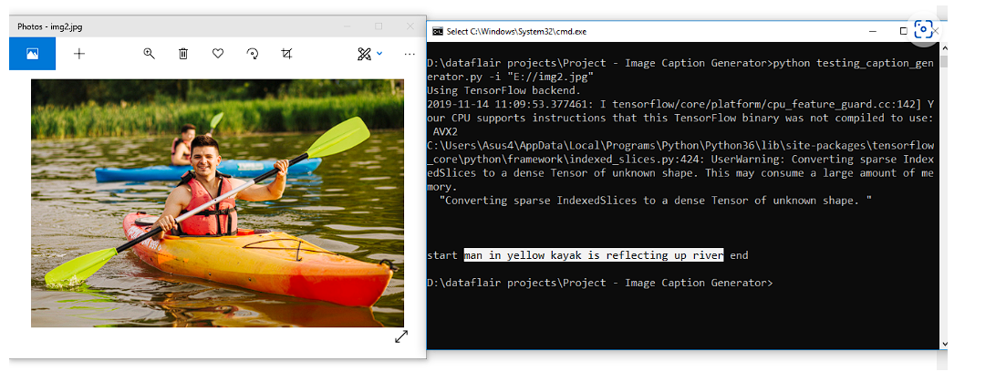
RESULTS
3/21/2024 Annual Review

